Slide 1







What does the picture board
suggest we’ll be learning about today?

Slide 2
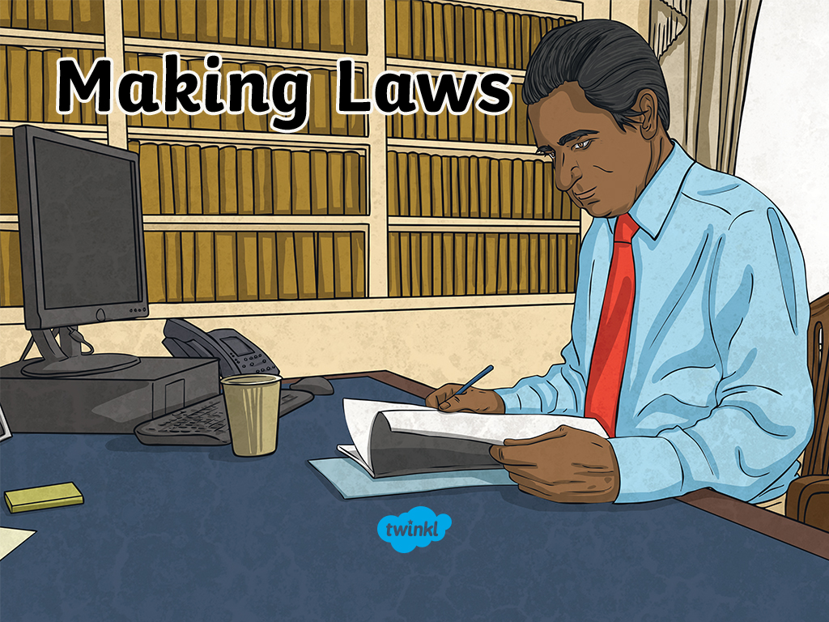

Slide 3
Learning Intentions
To discover how laws are made and why they are important.
To learn what role parliament plays in passing new laws and the importance of debate and scrutiny before new laws are made.
To recognise key terms such as law, bill, debate and scrutiny.
Success Criteria
I can understand the importance of having laws.
I can tell you why laws are made.
I can understand the role parliament plays in passing new laws.
I can explain some of the key terms associated with making laws.

Slide 4


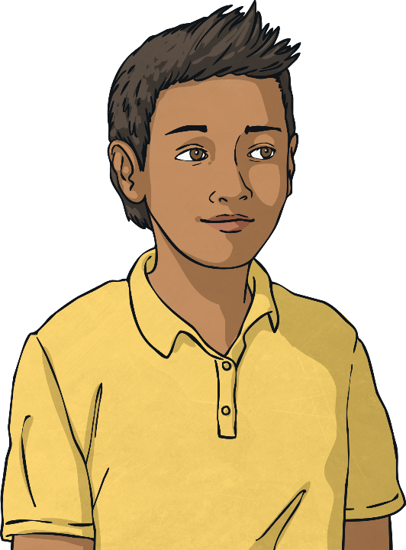
Making Laws
What is a law?
Why do we have laws?

Slide 5

Rules
If you know what rules are, then you will already know a bit about laws and how they work.
Rules help us to understand what we must and must not do.
You probably have a list of rules for your class that might include things like…
We look after our school property;
We raise our hands when we want to speak;
We stay in our seats;
We are friendly and supportive to others;
We always try our best.

Slide 6

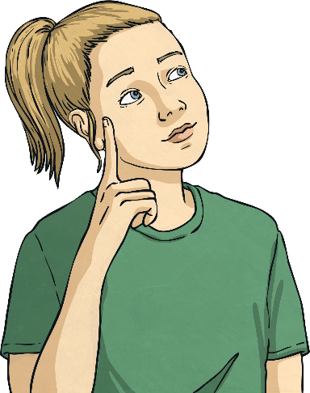
Why Do We Need Rules?
Why do you think we need rules like these?
What would your school be like without rules?
People in communities, like schools or clubs, often make up rules to help everyone get along.
Rules make sure things are fair and everyone is safe. If people break rules they might be told off or face a punishment of some sort.

Slide 7

Laws
Rules can affect small groups of people, but laws affect most of us.
Laws are based on the same ideas as rules, but they are different.
We don’t make laws ourselves. Laws are made in parliament.
Members of parliament and members of the senate debate and vote on ideas for new laws to make
sure they are the best they can be.
If people break the law, then they are doing something illegal and they might have to pay a fine, or even go to prison.

Slide 8
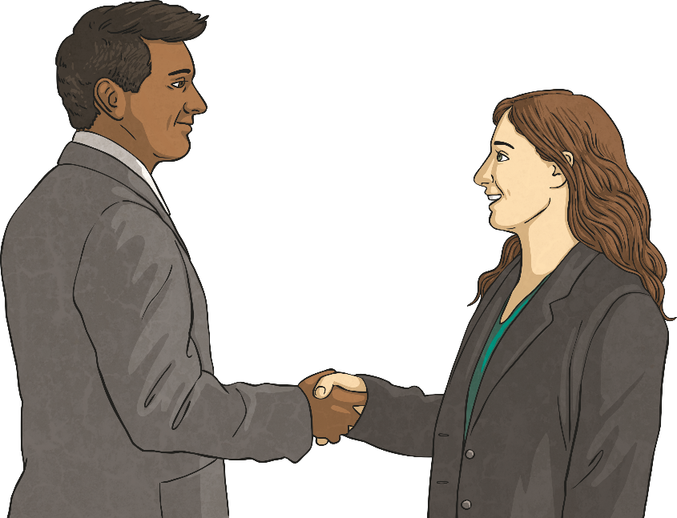
Laws Are Made To…
keep us safe and protect us;
ensure people behave so they don’t hurt themselves or others;
make sure everything is fair and people can access their rights;
solve conflicts (fights).

Slide 9
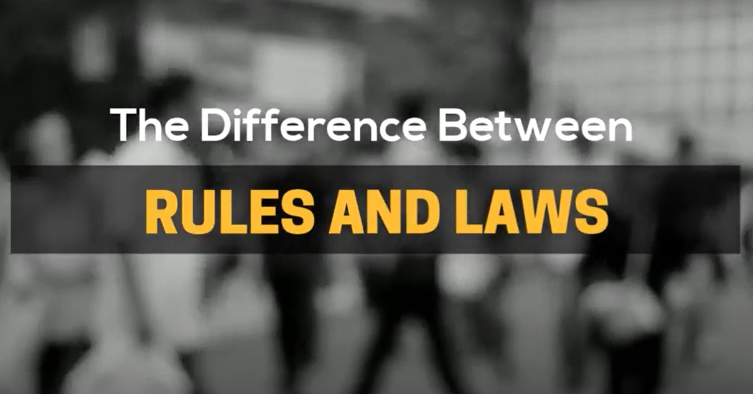

Watch the video closely, there is a quiz at the end
Notes:
YouTube: The Difference Between Rules and Laws
https://www.youtube.com/watch?v=nwEFPSqIApI
4 minutes

Slide 10
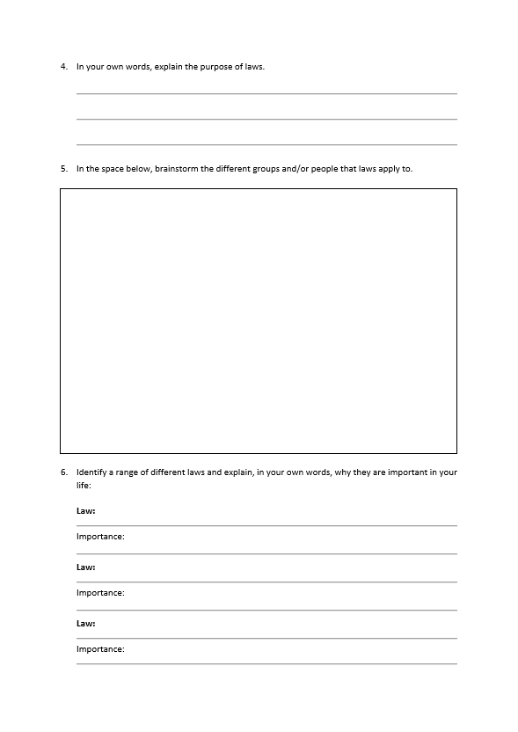
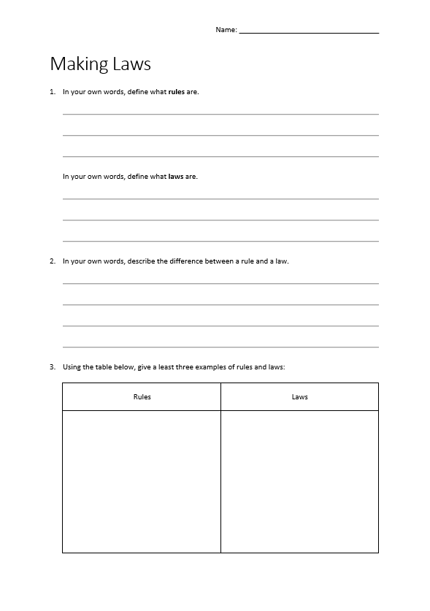
Activity Sheet

Slide 11
Part 2
Making Laws

Slide 12

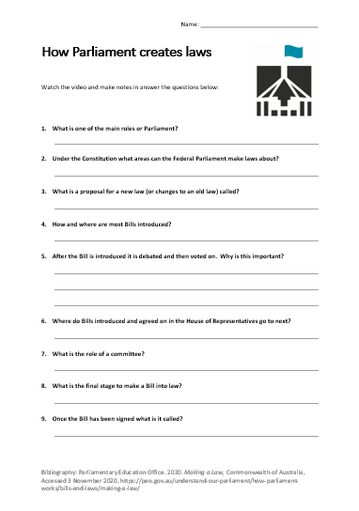
How Parliament makes laws
Watch the video, listen out for the answer and make notes on the question sheet.
Notes:
YouTube - About Parliament: Making a Law updated January 2018
https://www.youtube.com/watch?v=cTlrZ3HUAyE
3.40 mins

Slide 13
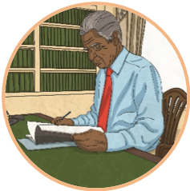

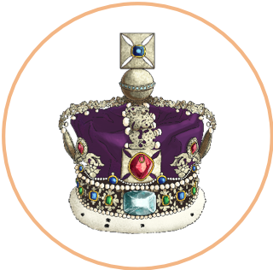
How Are Laws Made?
An idea for a law is called a bill.
Bills can be introduced by any member of parliament or member of the senate.
Bills are discussed and debated in detail in the house of representatives and the senate. They are considered carefully in order to make sure they will be effective. This is called scrutiny.
Sometimes a bill will move between the house of representatives and the senate many times before it is agreed upon. When this happens it is known as ping-pong!
If both houses agree on a bill, then it is signed by the governor-general. This is called, royal assent and the bill becomes an act of parliament and
part of Australian law.

Slide 14
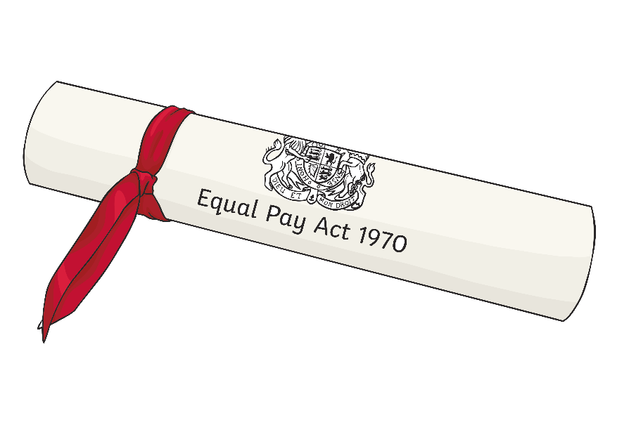
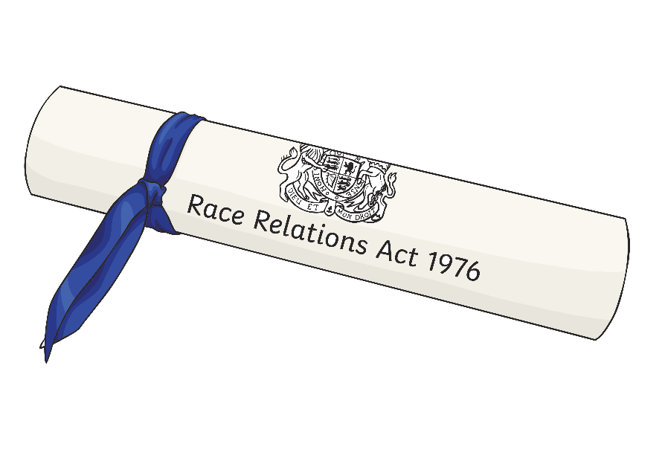
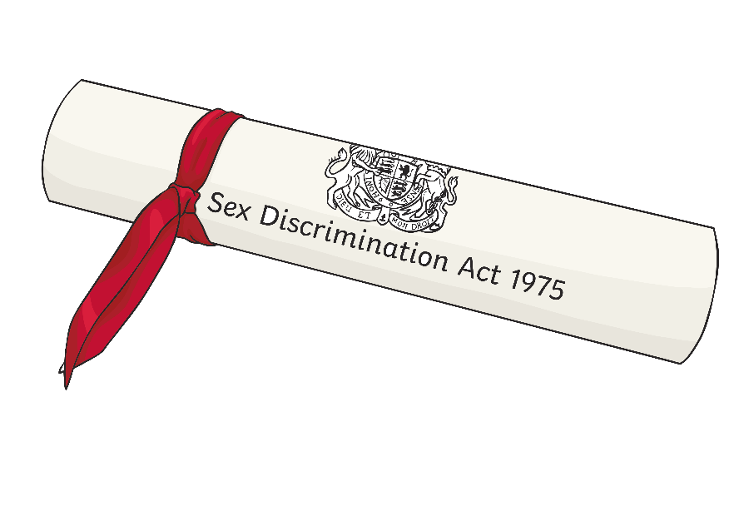
Optional Activities
Have a go at scrutinising a bill. Choose a bill to research and write down anything interesting that you find.

Slide 15
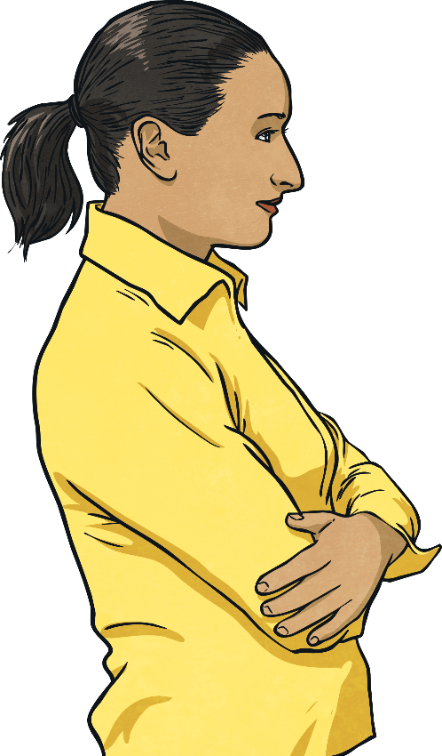
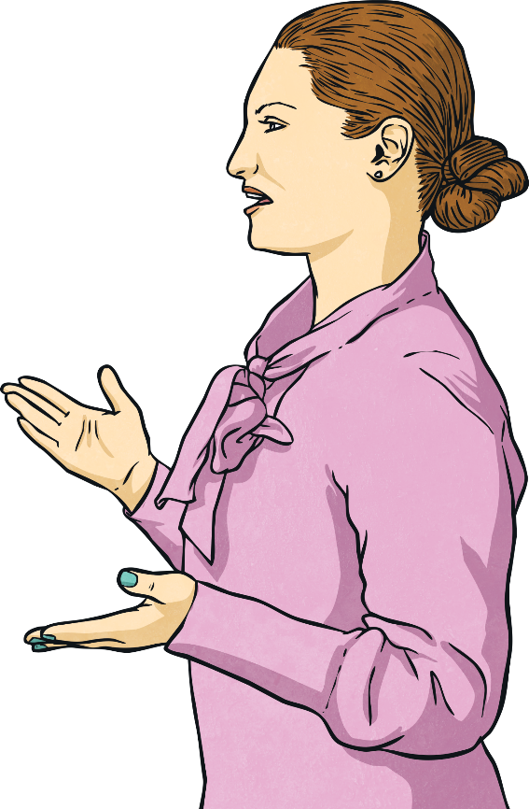
Optional Activities
Take part in the different stages of making a law.
Ideas (bills) are questioned and challenged in detail to make sure they are the best that they can be before members of the house of representatives and the senate pass them into new laws.

Slide 16
Success Criteria
I can understand the importance of having laws.
I can tell you why laws are made.
I can understand the role parliament plays in passing new laws.
I can explain some of the key terms associated with making laws.

Slide 17
